Slide 1
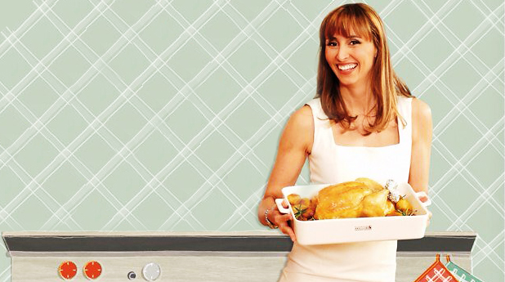
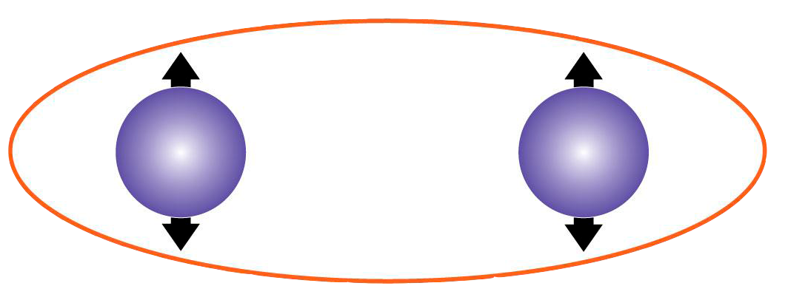
Gianvito Chiarella
Fakultät für Physik
LMU München

Slide 2
Ingredienti
Attrezzatura
Procedimento
Degustazione
Gianvito Chiarella
Fakultät für Physik
LMU München

Slide 3
Ingredienti
Attrezzatura
Procedimento
Degustazione

Slide 4
FAKULTÄT FÜR PHYSIK
Gianvito Chiarella
Ingredienti: stati di Bell
Spazio del sistema composto
$$H=H_{A}\text{⊗}H_{B}$$
, $d=d_{A}\text{∙}d_{B}$
Stato del sistema composto
$$|\left.ψ\right\rangle ={\left.|φ\right\rangle }_{A}\text{⊗}{\left.|φ\right\rangle }_{B}$$
Entanglement

Slide 5
FAKULTÄT FÜR PHYSIK
Gianvito Chiarella
Ingredienti: stati di Bell
$$|\left.0\right\rangle ,\left.|1\right\rangle$$
$$|\left.0\right\rangle ,\left.|1\right\rangle$$
$$H=H_{A}\text{⊗}H_{B}$$
2 qubits
, $d_{H}=4$
$$|\left.φ^{+}\right\rangle =\frac{1}{\sqrt{2}}\left[\left.|00\right\rangle +\left.|11\right\rangle \right]$$
Stati di Bell
(Max entangled)
$$|\left.φ^{−}\right\rangle =\frac{1}{\sqrt{2}}\left[\left.|00\right\rangle −\left.|11\right\rangle \right]$$
$$|\left.ψ^{−}\right\rangle =\frac{1}{\sqrt{2}}\left[\left.|01\right\rangle −\left.|10\right\rangle \right]$$
$$S_{max}=−\ln\left(\frac{1}{d}\right)$$
$$=ln⁡(2)⁡$$
$$|\left.ψ^{+}\right\rangle =\frac{1}{\sqrt{2}}\left[\left.|01\right\rangle +\left.|10\right\rangle \right]$$

Slide 6
Ingredienti
Attrezzatura
Procedimento
Degustazione

Slide 7
FAKULTÄT FÜR PHYSIK
Gianvito Chiarella
qubits
Attrezzatura...

Slide 8
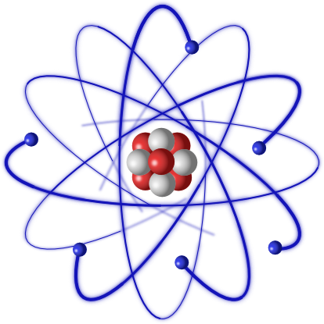
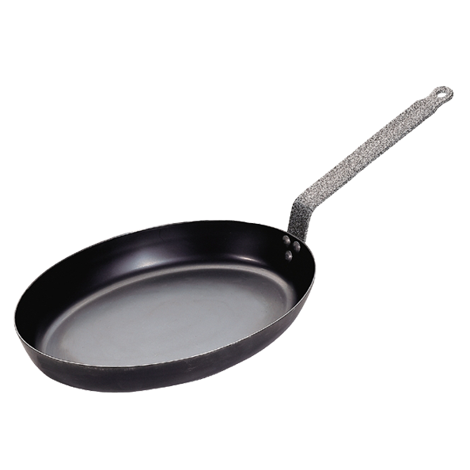
FAKULTÄT FÜR PHYSIK
Gianvito Chiarella
Attrezzatura...

Slide 9
FAKULTÄT FÜR PHYSIK
Gianvito Chiarella
Attrezzatura...

Slide 10
FAKULTÄT FÜR PHYSIK
Gianvito Chiarella
Qubits?
Struttura iper fine del ground state 6${}_{}^{2}{S_{1/2}}$del Cesio

Slide 11
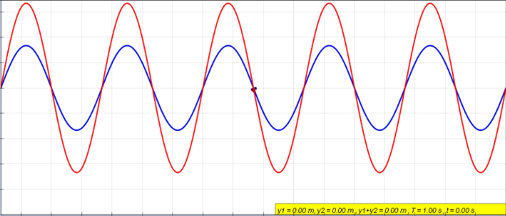
FAKULTÄT FÜR PHYSIK
Gianvito Chiarella
Reticoli ottici
Laser
Laser
ONDA STAZIONARIA originata dalla sovrapposizione di due fasci identici che si propagano in direzioni opposte

Slide 12
FAKULTÄT FÜR PHYSIK
Gianvito Chiarella
Reticoli ottici
$$\vec{F}=−\vec{∇}U_{dip}$$
$$α(ω)$$
$$U_{dip}=−\vec{d}∙\vec{E}=−α{\left|\vec{E}\right|}^{2}→U_{dip}∝I$$
Bose Einstein condensate
loaded in optical lattice

Slide 13
FAKULTÄT FÜR PHYSIK
Gianvito Chiarella
Reticoli ottici
$$\left.|0\right\rangle$$
$$\left.|1\right\rangle$$
Spin-dependent optical lattices
$$\left\langle n\right\rangle =1$$

Slide 14
Ingredienti
Attrezzatura
Procedimento
Degustazione

Slide 15
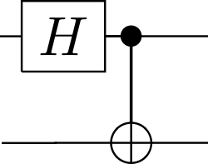
FAKULTÄT FÜR PHYSIK
Gianvito Chiarella
Il nostro Quantum circuit...
HADAMARD
$$\left.H|0\right\rangle =\frac{1}{\sqrt{2}}\left[\left.|0\right\rangle +\left.|1\right\rangle \right]$$
$$\left.|0\right\rangle$$
$$\left.H|1\right\rangle =\frac{1}{\sqrt{2}}\left[\left.|0\right\rangle −\left.|1\right\rangle \right]$$
C-NOT :
$\left.|00\right\rangle →$ $\left.|00\right\rangle$
$$\left.|0\right\rangle$$
$\left.|01\right\rangle →$ $\left.|01\right\rangle$
$\left.|10\right\rangle →$ $\left.|11\right\rangle$
C-NOT
$\left.|11\right\rangle →$ $\left.|10\right\rangle$

Slide 16
FAKULTÄT FÜR PHYSIK
Gianvito Chiarella
Il nostro Quantum circuit...
$$\left.|00\right\rangle →\frac{1}{\sqrt{2}}\left[\left.|0\right\rangle +\left.|1\right\rangle \right]\text{⊗}\left.|0\right\rangle$$
$$=\frac{1}{\sqrt{2}}\left[\left.|00\right\rangle +\left.|10\right\rangle \right]$$
$$\left.|0\right\rangle$$
$$→\frac{1}{\sqrt{2}}\left[\left.|00\right\rangle +\left.|11\right\rangle \right]$$
$$=|\left.φ^{+}\right\rangle$$
$$\left.|0\right\rangle$$

Slide 17
FAKULTÄT FÜR PHYSIK
Gianvito Chiarella
Il nostro Quantum circuit...
$$\left.|00\right\rangle →\frac{1}{\sqrt{2}}\left[\left.|0\right\rangle +\left.|1\right\rangle \right]\text{⊗}\left.|0\right\rangle =\frac{1}{\sqrt{2}}\left[\left.|00\right\rangle +\left.|10\right\rangle \right]$$
$$→\frac{1}{\sqrt{2}}\left[\left.|00\right\rangle +\left.|11\right\rangle \right]=|\left.φ^{+}\right\rangle$$
$$\left.|0\right\rangle$$
$$\left.|01\right\rangle →\frac{1}{\sqrt{2}}\left[\left.|01\right\rangle +\left.|11\right\rangle \right]→\frac{1}{\sqrt{2}}\left[\left.|01\right\rangle +\left.|10\right\rangle \right]=$$
$=|\left.ψ^{+}\right\rangle$
$$\left.|1\right\rangle$$

Slide 18
FAKULTÄT FÜR PHYSIK
Gianvito Chiarella
Il nostro Quantum circuit...
$$\left.|00\right\rangle →\frac{1}{\sqrt{2}}\left[\left.|0\right\rangle +\left.|1\right\rangle \right]\text{⊗}\left.|0\right\rangle =\frac{1}{\sqrt{2}}\left[\left.|00\right\rangle +\left.|10\right\rangle \right]$$
$$→\frac{1}{\sqrt{2}}\left[\left.|00\right\rangle +\left.|11\right\rangle \right]=|\left.φ^{+}\right\rangle$$
$$\left.|1\right\rangle$$
$$\left.|01\right\rangle →\frac{1}{\sqrt{2}}\left[\left.|01\right\rangle +\left.|11\right\rangle \right]→\frac{1}{\sqrt{2}}\left[\left.|01\right\rangle +\left.|10\right\rangle \right]=$$
$=|\left.ψ^{+}\right\rangle$
$$\left.|0\right\rangle$$
$\left.|10\right\rangle →\frac{1}{\sqrt{2}}\left[\left.|00\right\rangle −\left.|11\right\rangle \right]$ $=|\left.φ^{−}\right\rangle$

Slide 19
FAKULTÄT FÜR PHYSIK
Gianvito Chiarella
Il nostro Quantum circuit...
$$\left.|00\right\rangle →\frac{1}{\sqrt{2}}\left[\left.|0\right\rangle +\left.|1\right\rangle \right]\text{⊗}\left.|0\right\rangle =\frac{1}{\sqrt{2}}\left[\left.|00\right\rangle +\left.|10\right\rangle \right]$$
$$→\frac{1}{\sqrt{2}}\left[\left.|00\right\rangle +\left.|11\right\rangle \right]=|\left.φ^{+}\right\rangle$$
$$\left.|1\right\rangle$$
$$\left.|01\right\rangle →\frac{1}{\sqrt{2}}\left[\left.|01\right\rangle +\left.|11\right\rangle \right]→\frac{1}{\sqrt{2}}\left[\left.|01\right\rangle +\left.|10\right\rangle \right]=$$
$=|\left.ψ^{+}\right\rangle$
$$\left.|1\right\rangle$$
$\left.|10\right\rangle →\frac{1}{\sqrt{2}}\left[\left.|00\right\rangle −\left.|11\right\rangle \right]$ $=|\left.φ^{−}\right\rangle$
$\left.|11\right\rangle →\frac{1}{\sqrt{2}}\left[\left.|01\right\rangle −\left.|10\right\rangle \right]$ $=|\left.ψ^{−}\right\rangle$

Slide 20
FAKULTÄT FÜR PHYSIK
Gianvito Chiarella
Quantum gates nel reticolo ottico : Base
$$\left.|0\right\rangle \left.|0\right\rangle$$
$$\left.|1\right\rangle \left.|0\right\rangle$$
$$\left.|0\right\rangle \left.|1\right\rangle$$
$$\left.|1\right\rangle \left.|1\right\rangle$$

Slide 21
FAKULTÄT FÜR PHYSIK
Gianvito Chiarella
Quantum gates nel reticolo ottico
Hadamard: impulso $\frac{π}{2}$ con $ω \sim 10 GHz$

Slide 22
FAKULTÄT FÜR PHYSIK
Gianvito Chiarella
Quantum gates nel reticolo ottico

Slide 23
FAKULTÄT FÜR PHYSIK
Gianvito Chiarella
Quantum gates nel reticolo ottico

Slide 24
FAKULTÄT FÜR PHYSIK
Gianvito Chiarella
Quantum gates nel reticolo ottico
$$\left.|00\right\rangle$$

Slide 25
FAKULTÄT FÜR PHYSIK
Gianvito Chiarella
Quantum gates nel reticolo ottico
$$\left.|11\right\rangle$$

Slide 26
FAKULTÄT FÜR PHYSIK
Gianvito Chiarella
Quantum gates nel reticolo ottico
$$\left.|01\right\rangle$$

Slide 27
FAKULTÄT FÜR PHYSIK
Gianvito Chiarella
Quantum gates nel reticolo ottico
$$\left.|10\right\rangle$$
$$\left.e^{iHt/ℏ}|10\right\rangle \left.{=e}^{φ(t)}|10\right\rangle \left.=−|10\right\rangle$$

Slide 28
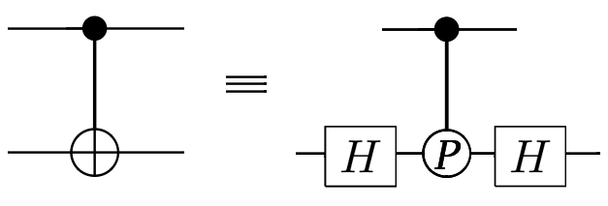
FAKULTÄT FÜR PHYSIK
Gianvito Chiarella
Quantum gates nel reticolo ottico
C-NOT
C-PHASE
$\left.|00\right\rangle →$ $\left.|00\right\rangle$
$\left.|00\right\rangle →$ $\left.|00\right\rangle$
$\left.|01\right\rangle →$ $\left.|01\right\rangle$
VS
$\left.|01\right\rangle →$ $\left.|01\right\rangle$
$\left.|10\right\rangle →$ $\left.|11\right\rangle$
$\left.|10\right\rangle →$ $\left.−|10\right\rangle$
$\left.|11\right\rangle →$ $\left.|10\right\rangle$
$\left.|11\right\rangle →$ $\left.|11\right\rangle$

Slide 29
Ingredienti
Attrezzatura
Procedimento
Degustazione

Slide 30
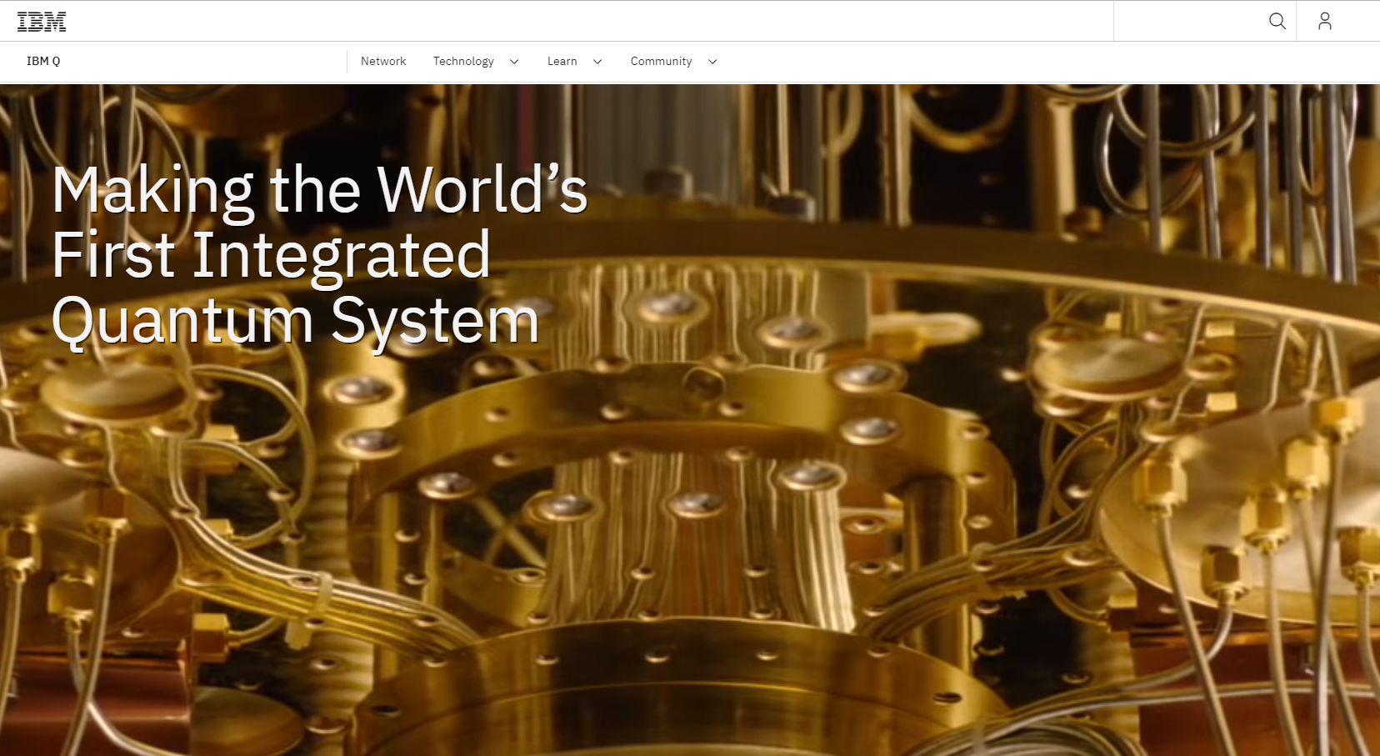
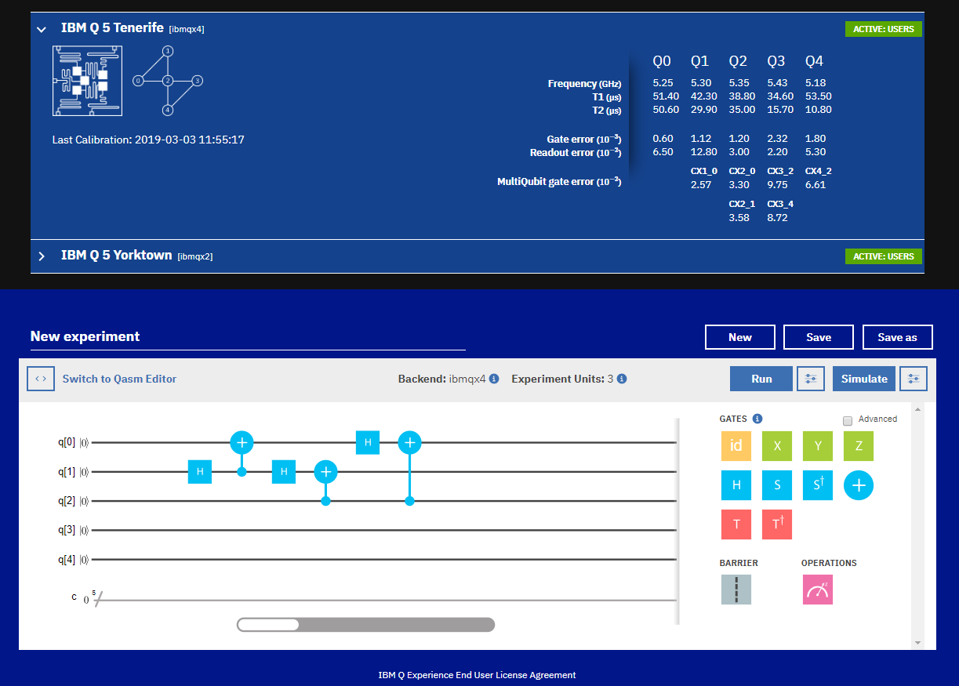
FAKULTÄT FÜR PHYSIK
Gianvito Chiarella
IBM

Slide 31
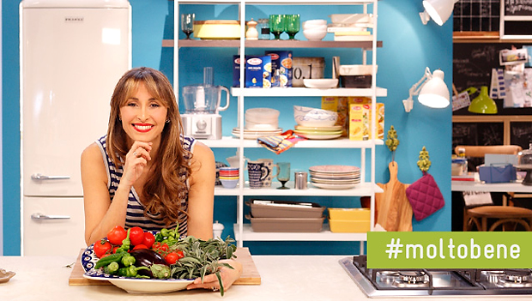
FAKULTÄT FÜR PHYSIK
Gianvito Chiarella
Grazie per
l’attenzione!
IBM
Gianvito Chiarella
Fakultät für Physik
LMU München
hoffame

Slide 32
Jaksch, D., Briegel, H. J., Cirac, J. I., Gardiner, C. W. & Zoller, P. Entanglement of atoms via cold controlled collisions. Phys. Rev. Lett. 82, 1975–1978 (1999).
Mandel, O. et al. Controlled collisions for multiparticle entanglement of optically trapped atoms. Nature 425, 937–940 (2003)
Zopes, J. Storing atoms in spin dependent optical lattices – Masterarbeit in Physik
Bloch, I. Quantum coherence and entanglement with ultracold atoms in optical lattices. Nature 453, 1016-1022 (2008)
Notes:
32
Vorstellung Mitarbeiter in der Studien- und Prüfungsverwaltung

